Slide 1
SURGICAL MANAGEMENT OF BRAINSTEM GLIOMA

Slide 2
Brainstem tumor classification systems
Author & Year | Method used to create system
Epstein 1985 | CT
Epstein & McCleary 1986 | CT, MRI and Surgical Observation
Stroink et al, 1987 | CT
Darkovich et al, 1990 | MRI
Albright, 1996 | MRI
Fischbein et al, 1996 | MRI

Slide 3
Brainstem tumor classification systems
Choux el al., 2000 CT & MRI Type I: diffuse
Tape II: intrinsic, focal
Type Ill: exophytic, focal
Type IV: cervicomedulIary

Slide 4
DIFFUSE BSG
Diffuse BSG-
  Hypo on T1, hyper on T2, inhomogenous contrast enhancement within or around the tumour.
  Contrast enhancement in only 1/3rd cases.
  No significant difference in prognosis with/without contrast enhancement.

Slide 5
FOCAL BSG
Focal BSG
  Well circumscribed, of limited size, may be partially cystic
  Midbrain >Medulla>Pons
  Hypo on T1, hyper on T2, nidus of focal enhancement
  Usually pilocytic astrocytomas

Slide 6
DORSAL EXOPHYTIC BSG
Dorsally exophytic BSG-
  Intra-IV th ventricular tm
  Resemble vermian astrocytoma with involvement of IV th ventricular floor

Slide 7
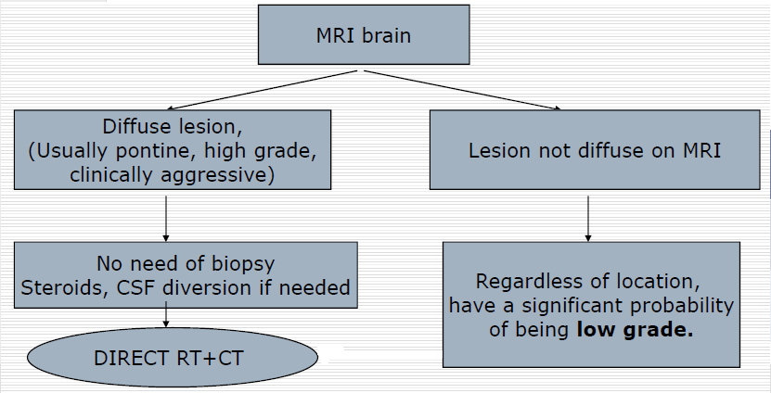
Practical decisions regarding treatment of BSG

Slide 8
Intraoperative monitoring
Cranial nerves-
  EMG monitoring – III,IV,V,VI,VII, IX,X,XI,XII
  BAEP – VIII nerve
SSEP and MEP - tracts

Slide 9
SSEP –
Monitors Dorsal column integrity
Stimulation sites UL – Median/Ulnar nerves LL -- Posterior tibial nerve
>= 50% decrease in amplitude and associated 10% increase in latency – significant

Slide 10
BAEP
Representation of electrical activity generated by the eighth cranial nerve and brainstem in response to auditory stimulation.

Slide 11
BAEP
Wave V is the most reliably seen wave
A shift in latency of 1 millisecond or a drop in amplitude of 50% could be significant.
changes occur, may be due to improper retraction on the cerebellum and brain stem.
Reversible with change of position of the retractors

Slide 12
Choice of approach
Location of lesion
Area to which lesion come close to pial surface
Clinical status of patient
Comfort of individual surgeon

Slide 13
Midbrain /
Thalamus
Pontomesencephalic
1.OZ
2. Lateral
SCIT
Pons
Lateral SCIT
Pontomedullary
1. CPA. Retrosigmoid
2. Medial MCP - suboccipital ± telovelar
3. Lateral/high MCP - Retrosigmoid/lateral SCIT
Cervicomeduullary
1. Retrosigmoid
2. Far lateral
1. Suboccipital
2. Far lateral

Slide 14
Planned approach for ventral lesions
Ventral / lateral
rostral to cranial nerve V Transsylvian / subtemporal
Between lower nerve and cranial Presigmoid / retrosigmoid
nerve V
Caudal to lower group Far lateral
CHEN ET AL- NEUROSURGERY
VOLUME 68 I NUMBER 31 MARCH 2011,

Slide 15
Planned approach for dorsal lesions
Dorsal
Midbrain Suboccipital transtentorial/
supracerebellar infratentorial
Floor of fourth ventricle Transcerebellomedullary fissure
Medulla intertonsillar
CHEN ET AL - NEUROSURGERY
VOLUME 681 NUMBER 31 MARCH 2011,

Slide 16
Safe entry zones to brainstem - Rationale
The 2-point method was used as an objective means to choose the surgical approach
One point is placed in the center of the lesion, and a second point is placed either where the lesion comes closest to a pial surface or at the safest entry point into the brainstem.

Slide 17
PONS
Ventral and ventro-lateral pons approached by
  Retro Sigmoid approach
  Pre sigmoid approcah
  Trans petrosal approach

Slide 18
Safe entry zone for ventro lateral pons
Peritrigeminal zone between emergence of fifth and seventh nerve located medially to fifth and lateral to pyramidal tract.
Fibers are directed horizontally so myelotomy should be in horizontal direction.
Surgical window –
  Horizontal – 4.64mm ( 3.8 – 5.6 mm)
  Vertical - 11.2 mm (9.5- 13.1mm)
Recalde R. MICROSURGICAL ANATOMY OF THE SAFE ENTRY ZONES ON THE ANTEROLATERAL BRAINSTEM RELATED TO SURGICAL APPROACHES TO CAVERNOUS MALFORMATIONS. Neurosurgery, 2008.

Slide 19
Suprafacial Triangle
1 cm longitudinal incision from edge cerebellar peduncle and 5mm lateral to median sulcus
Length of incision –7mm
MLP
1cm
Cerebellar peduncle
Kmn
Facial nerve
Kyoshima K,Kobayashi S et al.A study of safe entry zones via the floor of the fourth
ventricle for brain-stem lesions.
Report of three cases. JNS 1993

Slide 20
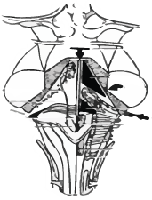
Infrafacial Triangle
1 cm longitudinal incision above striae medullaris
and 5 mm lateral to
median sulcus
Facial colliculus
Abducens PFFF
Facial nerve
1cm
MLF
4-5 mm
Facial
Striae medullares
Kyoshima K,Kobayashi S et al.A study of safe entry zones via the floor of the fourth
ventricle for brain-stem lesions.
Report of three cases. JNS 1993

Slide 21
Ventral medulla
Safe corridors –
  at level of retro olivary sulcus
  between cranial nerve 12 and C1 at level of anterolateral sulcus
Surgical window –
  cranio-caudal - 13.5 mm
  Transverse - 7 mm
  antero-dorsal - 2.5mm

Slide 22
Dorsal medulla
Safe corridors –
  Posterior median fissure - below obex ,between nucleus of gracile fasciculus
  posterior intermediate sulcus – between gracile and cuneate fascile
  Posterior lateral sulcus - between cuneate fascile medially and spinal trigeminal tract and nucleus laterally

Slide 23
Ventral Midbrain
Safe entry zone – lateral to cranial nerve III , between SCA and PCA and medial to pyramidal tract
Bricolo A, Turazzi S:Adv Tech Stand Neurosurg 22:261– 341, 1995

Slide 24
Ventro lateral midbrain
Safe entry zone is lateral mesencephalic sulcus (LMS)
  Minimum working distance – 4.9 mm
  Maximum working distance – 11.7 mm
  Mean +- SD - 8.2 +- 1.76 mm

Slide 25
Safe entry zone for posterior midbrain
Structure | Dysfunction
Superior Colliculus | Pupillary disturbance, gaze palsy
Inferior Colliculus | Difficuly in localizing sound in space

Slide 26
Surgical technique-
Almost all BSTs are dorsally located, therefore should be approached through posterior fossa.
Position-prone(preferred)/sitting
Midline skin incision
Suboccipital craniotomy±cervical laminotomy
Y –shaped dural opening

Slide 27
Surgical technique-
Vermis coagulated and split at appropriate level.
Cerebellum held to the sides using self- retaining retractors ( avoid excessive side retraction – pseudobulbar palsy ).
IVth ventricle approached after division of medullary velum.

Slide 28
Tumour decompression
Conventional suction technique frequently causes brainstem dysfunction manifested by bradycardia & arrhythmia.
CUSA causes movement of adjacent structures only within 1mm of vibrating tip, allowing extensive and quick dissection adjacent to or within the substance of brainstem.

Slide 29
Surgical technique- Focal tumour
Rostral & caudal pole of the tumor be completely exposed.
Incision at an area where tumor is most superficial.
It also must be away from the midline and at least 1.5cm rostral to the obex - avoids injury to cr. nv nuclei X-XII.
Incision < 1cm.

Slide 30
Surgical technique- Focal tumor
Use of plated
bayonet(very small plates
at the tip) as ‘microretractor’.
CUSA at a low setting.
Careful identification of
white matter interface.
Minimal manipulation of adjacent normal tissue.

Slide 31
Surgical technique- Cervicomedullary tumor
Suboccipital craniotomy + osteoplastic laminotomy.
Expose both rostral and caudal extent of the tumor.
USG guidance to know extent of tumor prior to opening the dura - entire tumor should be within the confines of the operative exposure.

Slide 32
Surgical technique- Cervicomedullary tumour
Midline myelotomy
  ‘True’ midline to be identified
  Identify DREZ bilaterally
If tumor is solid-cystic, myelotomy to be placed first at tumor –cyst junction and cyst is removed prior to tumor excision.
If tumor is non-cystic, myelotomy where tumor is most voluminous & closest to the pial surface.

Slide 33
Surgical technique- Cervicomedullary tumour
Myelotomy to be terminated 1 cm proximal
to the caudal pole of the tumor → tumor is least
voluminous here, removed by gradual
upward dissection.
At the rostral pole, tumor invariably subpial and
bulging posteriorly at the obex.

Slide 34
Surgical technique- Cervicomedullary tumour
USG to guide the extent of tumor excision- to confirm bulk of tumor is removed.
Don’t chase small questionable fragments.
If deterioration of SSEP/MEP during the procedure, interrupt the dissection and move to another area.

Slide 35
Surgical technique-Cystic tumour
Bulge into the IV ventricle.
“Collapse” of the cyst cavity and surrounding neural tissue following cyst evacuation → difficulty in identifying the solid nodule.
‘Hand-held’ retractor compared to fixed.
Avoid frequent manipulation of retractor.

Slide 36
Surgical technique- Dorsally exophytic tumor
Major technical complication-injury to neural structures immediately below the ependymal lining.
Remove tumor “flush” with the floor of IV ventricle
Do not pursue tumor inside the brainstem.
Facial colliculus injury

Slide 37
Peri & post-operative care
Perioperative steroids( methylprednisolone)
Elective ventilation for at least 48 hours
Mechanical ventilation till recovery of ventilation & normal cough reflex
LCN paresis- NG/feeding gastrostomy
V,VII nv paresis- temporary tarsorrhaphy
Good nursing care
Physiotherapy
Post-op brainstem injury mostly reversible if surgical technique is proper

Slide 38
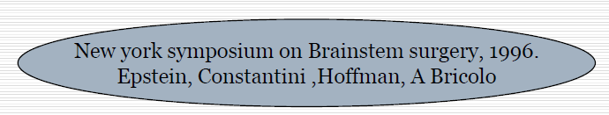
Role of stereotactic biopsy
Majority of focal, dorsally exophytic and cervicomedullary BSG are benign and resectable by direct surgery with low morbidity and good outcome.

Slide 39
Role of stereotactic biopsy
Reserved to
  When the diagnosis is uncertain, to rule out
  inflammatory pathology like TB.
  Focal intrinsic endophytic lesion- well limited
  masses within the brainstem surrounded by
  neural tissue and therefore do not reach the
  surface.

Slide 40
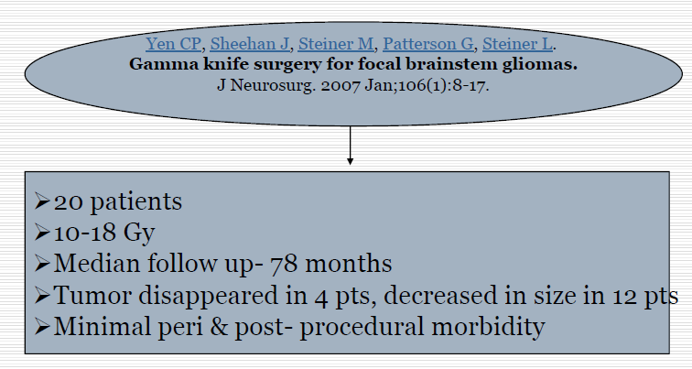
Role of GKRS

Slide 41
Journal quotes
”An aggressive surgical approach to patients with intrinsic brainstem tumors significantly improves overall survival(OS) and progression free survival (PFS) compared to adult non-surgical series.”
(OS) rate is 61% and progression free survival (PFS) is 45% at 5 years.
Neurosurgery:
August 2012
doi: 10.1227/01.neu.0000417806.84351.f0

Slide 42
Take home message
Knowledge of safe entry zones.
Diffuse tumor almost invariably malignant and should not be operated upon→ Direct RT + CT
Focal lesions : If laterally located & appears to be approachable with acceptable risks, resection is appropriate.
Radical excision possible
If more centrally located → Stereotactic biopsy + Irradiation

Slide 43
Thank You

